Slide 1


MOTIVATION
UNIT 9

Slide 2
LEARNING OUTCOME
Define motivation.
Compare and contrast early theories of motivation.
Compare and contrast contemporary theories of motivation.
Discuss current issues in motivation.

Slide 3
WHAT IS MOTIVATION?
Motivation - the process by which a person’s efforts are energized, directed, and sustained toward attaining a goal.
energy is a measure of intensity, drive, and vigor
effort is channeled in a direction that benefits the organization
We want employees to persist in putting forth effort
Notes:
Motivation refers to the process by which a person’s efforts are energized, directed, and sustained toward attaining a goal. This definition has three key elements: energy, direction, and persistence.
The energy element is a measure of intensity, drive, and vigor. A motivated person puts forth effort and works hard. However, the quality of the effort must be considered as well as its intensity. High levels of effort don’t necessarily lead to favorable job performance unless the effort is channeled in a direction that benefits the organization. Effort directed toward and consistent with organizational goals is the kind of effort we want from employees. Finally, motivation includes a persistence dimension. We want employees to persist in putting forth effort to achieve those goals.

Slide 4
EARLY THEORIES OF MOTIVATION
Maslow’s Hierarchy of Needs
McGregor’s Theories X and Y
Herzberg’s Two-Factor Theory
McClelland’s Three Needs Theory
Notes:
We begin by looking at four early motivation theories: Maslow’s hierarchy of needs, McGregor’s theories X and Y, Herzberg’s two-factor theory, and McClelland’s three needs theory. Although more valid explanations of motivation have been developed, these early theories are important because they represent the foundation from which contemporary motivation theories were developed and because many practicing managers
still use them.

Slide 5
MASLOW’S HIERARCHY OF NEEDS THEORY
Hierarchy of needs theory - Maslow’s theory that human needs — physiological, safety, social, esteem, and self-actualization — form a sort of hierarchy.
Physiological needs - a person’s needs for food, drink, shelter, sexual satisfaction, and other physical needs.
Notes:
The best-known theory of motivation is probably Abraham Maslow’s hierarchy of needs theory. Maslow was a psychologist who proposed that within every person is a hierarchy of five needs:
1. Physiological needs: A person’s needs for food, drink, shelter, sex, and other physical requirements.

Slide 6
MASLOW’S HIERARCHY OF NEEDS THEORY (CONT.)
Safety needs - a person’s needs for security and protection from physical and emotional harm.
Social needs - a person’s needs for affection, belongingness, acceptance, and friendship.
Notes:
2. Safety needs: A person’s needs for security and protection from physical and emotional harm as well as assurance that physical needs will continue to be met.
3. Social needs: A person’s needs for affection, belongingness, acceptance, and friendship.

Slide 7
MASLOW’S HIERARCHY OF NEEDS THEORY (CONT.)
Esteem needs - a person’s needs for internal factors (e.g., self-respect, autonomy, and achievement) and external factors (such as status, recognition, and attention).
Self-actualization needs - a person’s need to become what he or she is capable of becoming.
Notes:
4. Esteem needs: A person’s needs for internal esteem factors such as self-respect, autonomy, and achievement and external esteem factors such as status, recognition, and attention.
5. Self-actualization needs: A person’s needs for growth, achieving one’s potential, and self-fulfillment; the drive to become what one is capable of becoming.

Slide 8
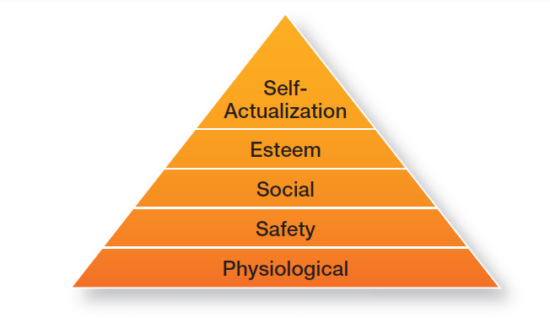
EXHIBIT 17-1 MASLOW’S HIERARCHY OF NEEDS
Notes:
Maslow argued that each level in the needs hierarchy must be substantially satisfied before the next need becomes dominant. An individual moves up the needs hierarchy from one level to the next. (See Exhibit 17-1.) In addition, Maslow separated the five needs into higher and lower levels. Physiological and safety needs were considered lower-order needs; social, esteem, and self-actualization needs were considered higher-order needs. Lower-order needs are predominantly satisfied externally while higher-order needs are satisfied internally.

Slide 9
MCGREGOR’S THEORY X AND THEORY Y
Theory X - the assumption that employees dislike work, are lazy, avoid responsibility, and must be coerced to perform.
Theory Y - the assumption that employees are creative, enjoy work, seek responsibility, and can exercise self-direction.
Notes:
Douglas McGregor is best known for proposing two assumptions about human nature: Theory X and Theory Y. Very simply, Theory X is a negative view of people that assumes workers have little ambition, dislike work, want to avoid responsibility, and need to be closely controlled to work effectively. Theory Y is a positive view that assumes employees enjoy work, seek out and accept responsibility, and exercise self-direction. McGregor believed that Theory Y assumptions should guide management practice and proposed that participation in decision making, responsible and challenging jobs, and good group relations would maximize employee motivation.

Slide 10
HERZBERG’S TWO-FACTOR THEORY
Two-factor theory (motivation-hygiene theory) - the motivation theory that claims that intrinsic factors are related to job satisfaction and motivation, whereas extrinsic factors are associated with job dissatisfaction.
Notes:
Frederick Herzberg’s two-factor theory (also called motivation-hygiene theory) proposes that intrinsic factors are related to job satisfaction, while extrinsic factors are associated with job dissatisfaction.

Slide 11
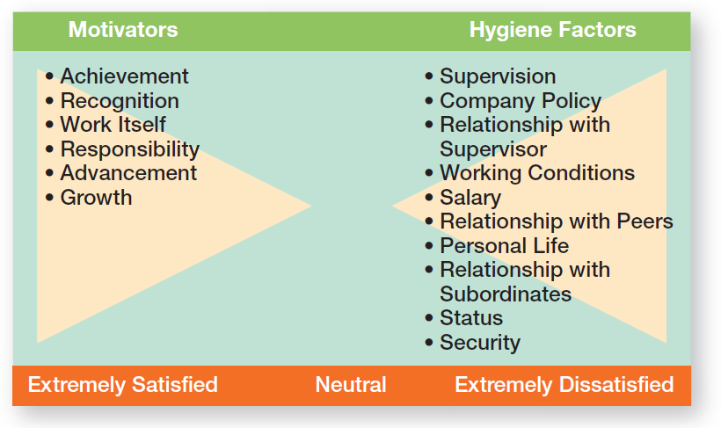
EXHIBIT 17-2 HERZBERG’S TWO FACTOR THEORY
Notes:
Herzberg wanted to know when people felt exceptionally good (satisfied) or bad (dissatisfied) about their jobs. (These findings are shown in Exhibit 17-2.) He concluded that the replies people gave when they felt good about their jobs were significantly different from the replies they gave when they felt badly. Certain characteristics were consistently related to job satisfaction (factors on the left side of the exhibit), and others to job dissatisfaction (factors on the right side).

Slide 12
HERZBERG’S TWO-FACTOR THEORY (CONT.)
Hygiene factors - factors that eliminate job dissatisfaction, but don’t motivate.
Motivators - factors that increase job satisfaction and motivation.
Notes:
The extrinsic factors that create job dissatisfaction were called hygiene factors. When these factors are adequate, people won’t
be dissatisfied, but they won’t be satisfied (or motivated) either. To motivate people, Herzberg suggested emphasizing motivators, the intrinsic factors having to do with the job itself.

Slide 13
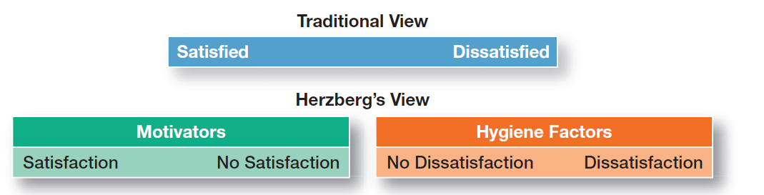
EXHIBIT 17-3 CONTRASTING VIEWS OF SATISFACTION– DISSATISFACTION
Notes:
Herzberg believed the data suggested that the opposite of satisfaction was not dissatisfaction, as traditionally had been believed. Removing dissatisfying characteristics from a job would not necessarily make that job more satisfying (or motivating). As shown in Exhibit 17-3, Herzberg proposed that a dual continuum existed: The opposite of “satisfaction” is “no satisfaction,” and the opposite of “dissatisfaction” is “no dissatisfaction.”

Slide 14
MCCLELLAND’S THREE-NEEDS THEORY
Three-needs theory - the motivation theory that sites three acquired (non-innate) needs (achievement, power, and affiliation) as major motives in work.
Need for achievement (nAch) - the drive to succeed and excel in relation to a set of standards.
Notes:
David McClelland and his associates proposed the three-needs theory, which says three acquired (not innate) needs are major motives in work. These three needs include the need for achievement (nAch), the drive to succeed and excel in relation to a set of standards; the need for power (nPow), the need to make others behave in a way they would not have behaved otherwise; and the need for affiliation (nAff), the desire for friendly and close interpersonal relationships.
People with a high need for achievement are striving for personal achievement rather than for the trappings and rewards of success. They have a desire to do something better or more efficiently than it’s been done before.

Slide 15
THREE-NEEDS THEORY (CONT.)
Need for power (nPow) - the need to make others behave in a way that they would not have behaved otherwise.
Need for affiliation (nAff) - the desire for friendly and close interpersonal relationships
Notes:
The other two needs in this theory haven’t been researched as extensively as the need for achievement. However, we do know that the best managers tend to be high in the need for power and low in the need for affiliation.

Slide 16
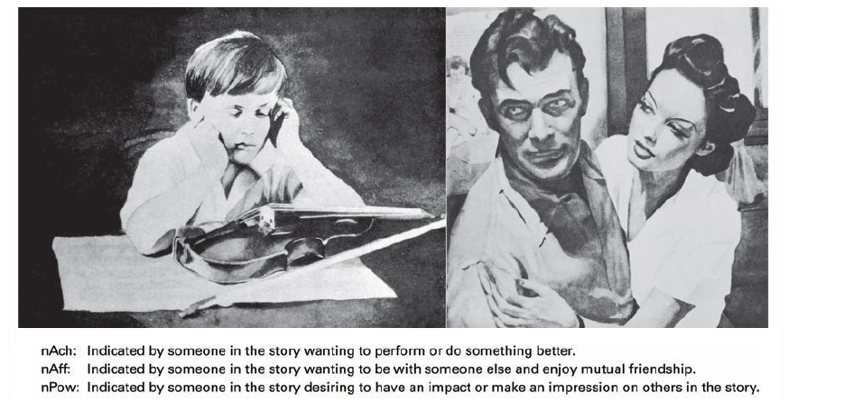
EXHIBIT 17-4 TAT PICTURES SOURCE
Notes:
All three of these needs can be measured by using a projective test (known as the Thematic Apperception Test or TAT) in which respondents react to a set of pictures. Each picture is briefly shown to a person who writes a story based on the picture. (See Exhibit 17-4 for some examples.) Trained interpreters then determine the individual’s levels of nAch, nPow, and nAff from the stories written.

Slide 17
CONTEMPORARY THEORIES OF MOTIVATION
Goal-setting theory - the proposition that specific goals increase performance and that difficult goals, when accepted, result in higher performance than do easy goals.
Self-efficacy - an individual’s belief that he or she is capable of performing a task.
Notes:
Research provides substantial support for goal-setting theory, which says that specific goals increase performance and that difficult goals, when accepted, result in higher performance than do easy goals.
Self-efficacy refers to an individual’s belief that he or she is capable of performing a task. The higher your self-efficacy, the more confidence you have in your ability to succeed in a task. So, in difficult situations, we find that people with low self-efficacy are likely to reduce their effort or give up altogether, whereas those with high self-efficacy will try harder to master the challenge.

Slide 18
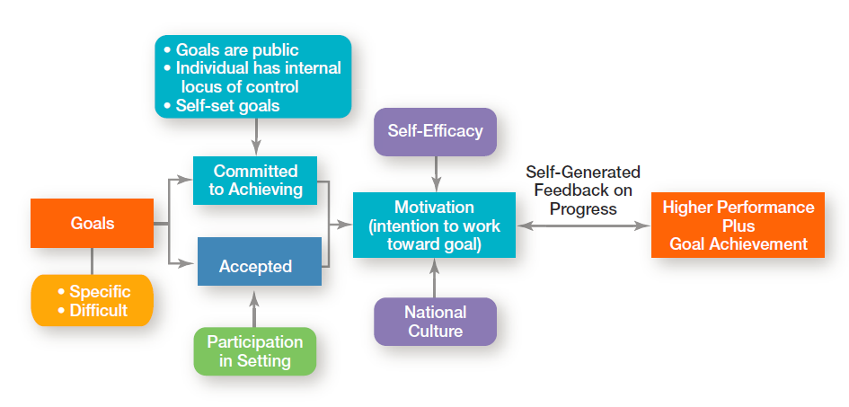
EXHIBIT 17-5 GOAL-SETTING THEORY
Notes:
Exhibit 17-5 summarizes the relationships among goals, motivation, and performance. One overall conclusion is that the intention to work toward hard and specific goals is a powerful motivating force. Under the proper conditions, it can lead to higher performance. However, no evidence indicates that such goals are associated with increased job satisfaction.

Slide 19
REINFORCEMENT THEORY
Reinforcement theory - the theory that behavior is a function of its consequences.
Reinforcers - consequences immediately following a behavior which increase the probability that the behavior will be repeated.
Notes:
Reinforcement theory says that behavior is a function of its consequences. Those consequences that immediately follow a behavior and increase the probability that the behavior will be repeated are called reinforcers. Reinforcement theory ignores factors such as goals, expectations, and needs. Instead, it focuses solely on what happens to a person when he or she does something.

Slide 20
DESIGNING MOTIVATING JOBS
Job design - the way tasks are combined to form complete jobs.
Job scope - the number of different tasks required in a job and the frequency with which those tasks are repeated.
Job enlargement - the horizontal expansion of a job that occurs as a result of increasing job scope.
Notes:
Because managers want to motivate individuals on the job, we need to look at ways to design motivating jobs. We use the term job design to refer to the way tasks are combined to form complete jobs. The jobs people perform in an organization should not evolve by chance. Managers should design jobs deliberately and thoughtfully to reflect the demands of the changing environment; the organization’s technology;
and employees’ skills, abilities, and preferences.
An early effort at overcoming the drawbacks of job specialization involved horizontally expanding a job through increasing job scope—the number of different tasks required in a job and the frequency with which these tasks are repeated. For instance, a dental hygienist’s job could be enlarged so that in addition to cleaning teeth, he or she is pulling patients’ files, refiling them when finished, and sanitizing and storing
instruments. This type of job design option is called job enlargement.

Slide 21
DESIGNING MOTIVATING JOBS (CONT.)
Job enrichment - the vertical expansion of a job that occurs as a result of additional planning and evaluation of responsibilities.
Job depth - the degree of control employees have over their work.
Job characteristics model (JCM) - a framework for analyzing and designing jobs that identifies five primary core job dimensions, their interrelationships, and their impact on outcomes.
Notes:
Another approach to job design is the vertical expansion of a job by adding planning and evaluating responsibilities—job enrichment.
Job enrichment increases job depth, which is the degree of control employees have over their work. In other words, employees are empowered to assume some of the tasks typically done by their managers. Thus, an enriched job allows workers to do an entire activity with increased freedom, independence, and responsibility.
Even though many organizations implemented job enlargement and job enrichment programs and experienced mixed results, neither
approach provided an effective framework for managers to design motivating jobs. But the job characteristics model (JCM) does. It identifies five core job dimensions, their interrelationships, and their impact on employee productivity, motivation, and satisfaction.

Slide 22
FIVE CORE JOB DIMENSIONS
Skill variety, the degree to which a job requires a variety of activities so that an employee can use a number of different skills and talents.
Task identity, the degree to which a job requires completion of a whole and identifiable piece of work.
Notes:
These five core job dimensions are:
1. Skill variety, the degree to which a job requires a variety of activities so that an employee can use a number of different skills and talents.
2. Task identity, the degree to which a job requires completion of a whole and identifiable piece of work.

Slide 23
FIVE CORE JOB DIMENSIONS (CONT.)
Task significance, the degree to which a job has a substantial impact on the lives or work of other people.
Autonomy, the degree to which a job provides substantial freedom, independence, and discretion to the individual in scheduling the work and determining the procedures to be used in carrying it out.
Notes:
Task significance, the degree to which a job has a substantial impact on the lives or work of other people.
4. Autonomy, the degree to which a job provides substantial freedom, independence, and discretion to the individual in scheduling the work and determining the procedures to be used in carrying it out.

Slide 24
FIVE CORE JOB DIMENSIONS (CONT.)
Feedback, the degree to which doing work activities required by a job results in an individual obtaining direct and clear information about the effectiveness of his or her performance.
Notes:
5. Feedback, the degree to which doing work activities required by a job results in an individual obtaining direct and clear information about the effectiveness of his or her performance.

Slide 25
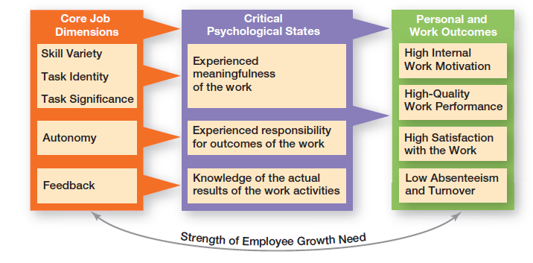
EXHIBIT 17-6 JOB CHARACTERISTICS MODEL
Notes:
The JCM is shown in Exhibit 17-6. Notice how the first three dimensions—skill variety, task identity, and task significance—combine to create meaningful work.

Slide 26
REDESIGNING JOB DESIGN APPROACHES
Relational perspective of work design - an approach to job design that focuses on how people’s tasks and jobs are increasingly based on social relationships.
Proactive perspective of work design - an approach to job design in which employees take the initiative to change how their work is performed.
Notes:
Two emerging viewpoints on job design are causing a rethink of the JCM and other standard approaches. Let’s take a look at each perspective.
The first perspective, the relational perspective of work design, focuses on how people’s tasks and jobs are increasingly based on social relationships. In jobs today, employees have more interactions and interdependence with coworkers and others both inside and outside the organization. In doing their job, employees rely more and more on those around them for information, advice, and assistance. So what
does this mean for designing motivating jobs? It means that managers need to look at important components of those employee relationships such as access to and level of social support in an organization, types of interactions outside an organization, amount of task interdependence, and interpersonal feedback.
The second perspective, the proactive perspective of work design, says that employees are taking the initiative to change how their work is performed. They’re much more involved in decisions and actions that affect their work. Important job design factors according to this perspective include autonomy (which is part of the JCM), amount of ambiguity and accountability, job complexity, level of stressors,
and social or relationship context. Each of these has been shown to influence employee proactive behavior.

Slide 27
REDESIGNING JOB DESIGN APPROACHES (CONT.)
High-involvement work practices - work practices designed to elicit greater input or involvement from workers.
Notes:
One stream of research that’s relevant to proactive work design is high involvement work practices, which are designed to elicit greater input or involvement from workers. The level of employee proactivity is believed to increase as employees become more involved in decisions that affect their work. Another term for this approach, which we discussed in an earlier chapter, is employee empowerment.

Slide 28
EQUITY THEORY
Equity theory - the theory that an employee compares his or her job’s input-outcome ratio with that of relevant others and then corrects any inequity.
Referents - the persons, systems, or selves against which individuals compare themselves to assess equity.
Distributive justice - perceived fairness of the amount and allocation of rewards among individuals.
Notes:
Equity theory, developed by J. Stacey Adams, proposes that employees compare what they get from a job (outcomes) in relation to what they put into it (inputs), and then they compare their inputs–outcomes ratio with the inputs–outcomes ratios of relevant others (Exhibit 17-7). If an employee perceives her ratio to be equitable in comparison to those of relevant others, there’s no problem. However, if the ratio
is inequitable, she views herself as underrewarded or overrewarded. When inequities occur, employees attempt to do something about it. The result might be lower or higher productivity, improved or reduced quality of output, increased absenteeism, or voluntary resignation.
The referent—the other persons, systems, or selves individuals compare themselves against in order to assess equity—is an important variable in equity theory.
Originally, equity theory focused on distributive justice, the perceived fairness of the amount and allocation of rewards among individuals. More recent research has focused on looking at issues of procedural justice, the perceived fairness of the process used to determine the distribution of rewards.

Slide 29
EQUITY THEORY (CONT.)
Procedural justice - perceived fairness of the process used to determine the distribution of rewards
Notes:
Research shows that distributive justice has a greater influence on employee satisfaction than procedural justice, while procedural justice tends to affect an employee’s organizational commitment, trust in his or her boss, and intention to quit.

Slide 30
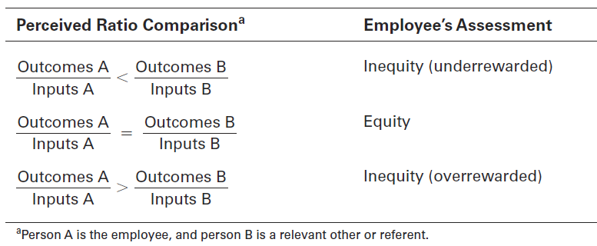
EXHIBIT 17-7 EQUITY THEORY

Slide 31
EXPECTANCY THEORY
Expectancy theory - the theory that an individual tends to act in a certain way based on the expectation that the act will be followed by a given outcome and on the attractiveness of that outcome to the individual.
Notes:
The most comprehensive explanation of how employees are motivated is Victor Vroom’s expectancy theory. Expectancy theory states that an individual tends to act in a certain way based on the expectation that the act will be followed by a given outcome and on the attractiveness of that outcome to the individual. It includes three variables or relationships (see Exhibit 17-8):

Slide 32
EXPECTANCY THEORY (CONT.)
Expectancy Relationships
Expectancy (effort-performance linkage)
The perceived probability that an individual’s effort will result in a certain level of performance.
Instrumentality
The perception that a particular level of performance will result in attaining a desired outcome (reward).
Valence
The attractiveness/importance of the performance reward (outcome) to the individual.
Notes:
Expectancy or effort–performance linkage is the probability perceived by the individual that exerting a given amount of effort will lead to a certain level of performance.
2. Instrumentality or performance–reward linkage is the degree to which the individual believes that performing at a particular level is
instrumental in attaining the desired outcome.
3. Valence or attractiveness of reward is the importance an individual places on the potential outcome or reward that can be achieved on the job. Valence considers both the goals and needs of the individual.

Slide 33
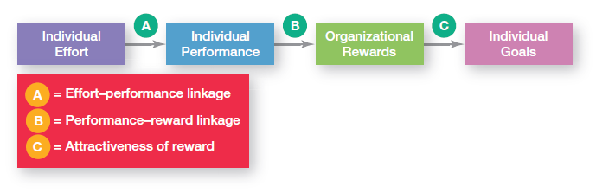
EXHIBIT 17-8 EXPECTANCY MODEL

Slide 34
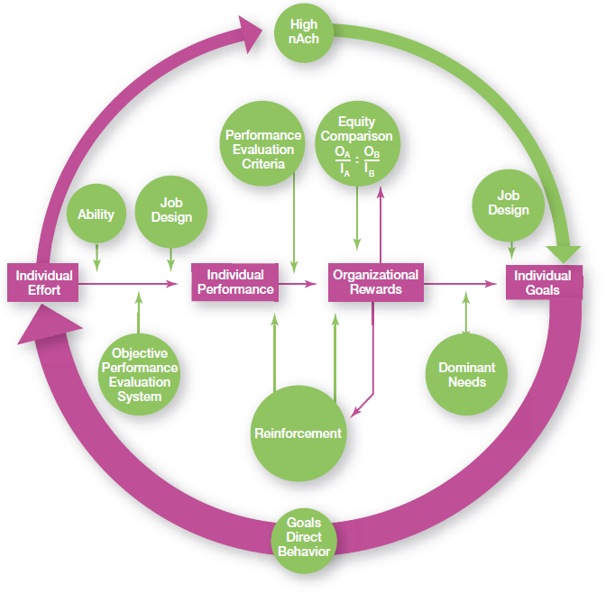
EXHIBIT 17-9 INTEGRATING CONTEMPORARY THEORIES OF MOTIVATION
Notes:
Many of the ideas underlying the contemporary motivation theories are complementary, and you’ll understand better how to motivate people if you see how the theories fit together. Exhibit 17-9 presents a model that integrates much of what we know about motivation. Its basic foundation is the expectancy model.
The individual effort box has an arrow leading into it. This arrow flows from the individual’s goals. Consistent with goal-setting theory, this goals–effort link is meant to illustrate that goals direct behavior. Expectancy theory predicts that an employee will exert a high level of effort if he or she perceives a strong relationship between effort and performance, performance and rewards, and rewards and satisfaction of personal goals. Each of these relationships is in turn influenced by certain factors. You can see from the model that the level of individual performance is determined not only by the level of individual effort but also by the individual’s ability to perform and by whether the organization has a fair and objective performance evaluation system. The performance–reward relationship will be strong if the individual perceives that performance (rather than seniority, personal favorites, or some other criterion) is what is rewarded. The final link in expectancy theory is the rewards–goal relationship. The traditional need theories come into play at this point. Motivation would be high to the degree that the rewards an individual
Received for his or her high performance satisfied the dominant needs consistent with his or her individual goals.

Slide 35
CURRENT ISSUES IN MOTIVATION
Motivating in Tough Economic Circumstances
The economic recession of the last few years was difficult for many organizations
Layoffs, tight budgets, minimal or no pay raises, benefit cuts, no bonuses, long hours doing the work of those who had been laid off— was the reality that many employees faced.
Notes:
The economic recession of the last few years was difficult for many organizations, especially when it came to their employees. Layoffs, tight budgets, minimal or no pay raises, benefit cuts, no bonuses, long hours doing the work of those who had been laid off—this was the reality that many employees faced. As conditions deteriorated, employee confidence, optimism, and job engagement plummeted as well. As you can
imagine, it wasn’t an easy thing for managers to keep employees motivated under such challenging circumstances.

Slide 36
CURRENT ISSUES IN MOTIVATION (CONT.)
Managing Cross-Cultural Motivational Challenges
Most current motivation theories were developed in the United States by Americans and about Americans
Managers can’t automatically assume motivational programs that work in one geographic location are going to work in others
Notes:
In today’s global business environment, managers can’t automatically assume motivational programs that work in one geographic location are going to work in others. Most current motivation theories were developed in the United States by Americans and about Americans. Maybe the most blatant pro-American characteristic in these theories is the strong emphasis on individualism and achievement. For instance, both
goal-setting and expectancy theories emphasize goal accomplishment as well as rational and individual thought.

Slide 37
CURRENT ISSUES IN MOTIVATION (CONT.)
Motivating Unique Groups of Workers
Compressed workweek
Longer daily hours, but fewer days
Flexible work hours (flextime)
Specific weekly hours with varying arrival, departure, lunch and break times around certain core hours during which all employees must be present
Job Sharing
Two or more people split a full-time job
Telecommuting
Employees work from home using computer links
Notes:
To maximize motivation among today’s workforce, managers need to think in terms of flexibility. For instance, studies tell us that men place more importance on having autonomy in their jobs than women. In contrast, the opportunity to learn, convenient and flexible work hours, and good interpersonal relations are more important to women. many organizations have developed flexible work arrangements—such as compressed workweeks, flextime, and job sharing that recognize different needs.

Slide 38
CURRENT ISSUES IN MOTIVATION (CONT.)
Motivating Professionals
Characteristics of professionals
Strong and long-term commitment to their field of expertise
Loyalty is to their profession, not to the employer
Have the need to regularly update their knowledge
Don’t define their workweek as 8:00 am to 5:00 pm.
Notes:
In contrast to a generation ago, the typical employee today is more likely to be a professional with a college degree than a blue-collar
factory worker. Professionals are different from nonprofessionals. They have a strong and long term commitment to their field of expertise
Their chief reward is the work itself. Professionals also value support. They want others to think that what they are working on is important. That may be true for all employees, but professionals tend to be focused on their work as their central life interest, whereas nonprofessionals
typically have other interests outside of work that can compensate for needs not met on the job.

Slide 39
CURRENT ISSUES IN MOTIVATION (CONT.)
Motivating Contingent Workers
Opportunity to become a permanent employee
Opportunity for training
Equity in compensation and benefits
Motivating Low-Skilled, Minimum-Wage Employees
Employee recognition programs
Provision of sincere praise
Notes:
What will motivate involuntarily temporary employees? An obvious answer is the opportunity to become a permanent employee. In cases in which permanent employees are selected from a pool of temps, the temps will often work hard in hopes of becoming permanent. A less obvious answer is the opportunity for training. The ability of a temporary employee to find a new job is largely dependent on his or her skills.
In motivating minimum-wage employees, managers might look at employee recognition programs. Many managers also recognize the power of praise although these “pats on the back” must be sincere and given for the right reasons.

Slide 40
DESIGNING APPROPRIATE REWARDS PROGRAMS
Open-book management - a motivational approach in which an organization’s financial statements (the “books”) are shared with all employees.
Employee recognition programs - programs based on personal attention and expression of interest, approval, and appreciation for a job well done.
Pay-for-performance programs - variable compensation plans that pay employees on the basis of some performance measure.
Notes:
Many organizations of various sizes involve their employees in workplace decisions by opening up the financial statements (the “books”). They share that information so employees will be motivated to make better decisions about their work and better able to understand the implications of what they do, how they do it, and the ultimate impact on the bottom line. This approach is called openbook management and many organizations are using it.
Employee recognition programs consist of personal attention and expressing interest, approval, and appreciation for a job well done. They can take numerous forms.
Pay-for-performance programs are variable compensation plans that pay employees on the basis of some performance measure.
Piece-rate pay plans, wage incentive plans, profit-sharing, and lump-sum bonuses are examples. What differentiates these forms of pay from more traditional compensation plans is that instead of paying a person for time on the job, pay is adjusted to reflect some performance measure.

Slide 41
REVIEW LEARNING OUTCOME 17.1
Define motivation.
Motivation is the process by which a person’s efforts are energized, directed, and sustained toward attaining a goal.
The energy element is a measure of intensity, drive, or vigor.
The high level of effort needs to be directed in ways that help the organization achieve its goals.
Employees must persist in putting forth effort to achieve those goals.
Notes:
Motivation is the process by which a person’s efforts are energized, directed, and sustained toward attaining a goal.
The energy element is a measure of intensity, drive, or vigor. The high level of effort needs to be directed in ways that help the organization achieve its goals. Employees must persist in putting forth effort to achieve those goals.

Slide 42
REVIEW LEARNING OUTCOME 17.2
Compare and contrast early theories of motivation.
In Maslow’s hierarchy, individuals move up the hierarchy of five needs (physiological, safety, social, esteem, and self-actualization).
A Theory X manager believes people don’t like to work or won’t seek out responsibility. A Theory Y manager assumes people like to work and seek out responsibility, so they will exercise self-motivation and self-direction.
Notes:
In Maslow’s hierarchy, individuals move up the hierarchy of five needs (physiological, safety, social, esteem, and self-actualization) as needs are substantially satisfied. A need that’s substantially satisfied no longer motivates.
A Theory X manager believes people don’t like to work or won’t seek out responsibility so they have to be threatened and coerced to work. A Theory Y manager assumes people like to work and seek out responsibility, so they will exercise self-motivation and self-direction.

Slide 43
REVIEW LEARNING OUTCOME 17.2 (CONT.)
Herzberg’s theory proposed that intrinsic factors associated with job satisfaction were what motivated people. Extrinsic factors associated with job dissatisfaction simply kept people from being dissatisfied.
Three-needs theory proposed three acquired needs that are major motives in work: need for achievement, need for affiliation, and need for power.
Notes:
Herzberg’s theory proposed that intrinsic factors associated with job satisfaction were what motivated people. Extrinsic factors associated with job dissatisfaction simply kept people from being dissatisfied. Three-needs theory proposed three acquired needs that are major motives
in work: need for achievement, need for affiliation, and need for power.

Slide 44
REVIEW LEARNING OUTCOME 17.3
Compare and contrast contemporary theories of motivation.
Goal-setting theory says that specific goals increase performance, and difficult goals, when accepted, result in higher performance than easy goals.
Reinforcement theory says that behavior is a function of its consequences.
Job enlargement involves horizontally expanding job scope.
Notes:
Goal-setting theory says that specific goals increase performance, and difficult goals, when accepted, result in higher performance than easy goals. Important points in goal-setting theory include intention to work toward a goal as a major source of job motivation; specific hard goals that produce higher levels of output than generalized goals; participation in setting goals as preferable to assigning goals, but not always; feedback that guides and motivates behavior, especially self-generated feedback; and contingencies that affect goal setting—goal commitment, self-efficacy, and national culture.
Reinforcement theory says that behavior is a function of its consequences. To motivate, use positive reinforcers to reinforce desirable behaviors. Ignore undesirable behavior rather than punishing it.
Job enlargement involves horizontally expanding job scope by adding more tasks or increasing how many times the tasks are done.

Slide 45
REVIEW LEARNING OUTCOME 17.3 (CONT.)
Job enrichment vertically expands job depth by giving employees more control over their work.
The job characteristics model says five core job dimensions (skill variety, task identity, task significance, autonomy, and feedback) are used to design motivating jobs.
Notes:
Job enrichment vertically expands job depth by giving employees more control over their work.
The job characteristics model says five core job dimensions (skill variety, task identity, task significance, autonomy, and feedback) are used to design motivating jobs. Another job design approach proposed looking at relational aspects and proactive aspects of jobs.

Slide 46
REVIEW LEARNING OUTCOME 17.3 (CONT.)
Expectancy theory says an individual tends to act in a certain way based on the expectation that the act will be followed by a desired outcome.
Equity theory focuses on how employees compare their inputs–outcomes ratios to relevant others’ ratios.
Notes:
Equity theory focuses on how employees compare their inputs–outcomes ratios to relevant others’ ratios. A perception of inequity will cause an employee to do something about it. Procedural justice has a greater influence on employee satisfaction than distributive justice.
Expectancy theory says an individual tends to act in a certain way based on the expectation that the act will be followed by a desired outcome. Expectancy is the effort–performance linkage (how much effort do I need to exert to achieve a certain level of performance?); instrumentality is the performance–reward linkage (achieving at a certain level of performance will get me a specific reward); and valence is the attractiveness of the reward (is it the reward that I want?).

Slide 47
REVIEW LEARNING OUTCOME 17.4
Discuss current issues in motivation.
Managers must cope with four current motivation issues:
motivating in tough economic circumstances
managing cross-cultural challenges
motivating unique groups of workers
designing appropriate rewards programs.
Notes:
Managers must cope with four current motivation issues: motivating in tough economic circumstances, managing cross-cultural challenges, motivating unique groups of workers, and designing appropriate rewards programs.
During tough economic conditions, managers must look for creative ways to keep employees’ efforts energized, directed, and sustained toward achieving goals.
Most motivational theories were developed in the United States and have a North American bias. Some theories (Maslow’s need hierarchy, achievement need, and equity theory) don’t work well for other cultures. However, the desire for interesting work seems important to all workers and Herzberg’s motivator (intrinsic) factors may be universal.
Managers face challenges in motivating unique groups of workers. A diverse workforce is looking for flexibility. Professionals want job challenge and support and are motivated by the work itself. Contingent workers want the opportunity to become permanent or to receive skills training. Recognition programs and sincere appreciation for work done can be used to motivate low-skilled, minimum-wage workers.
Open-book management is when financial statements (the books) are shared with employees who have been taught what they mean. Employee recognition programs consist of personal attention, approval, and appreciation for a job well done. Pay-for-performance
programs are variable compensation plans that pay employees on the basis of some performance measure.

Slide 48

ANY QUESTION?

Slide 49

END OF LESSON

